Slide 1
Welcome
Sustainable Earth Buildings
CobBauge Phase 2 Kick-off Event
21st November, ESITC

Slide 2
Agenda
17h / 5 PM: Présentation du projet / Project presentation
•Introduction/ Introduction–Mohamed Boutouil(ESITC Caen)
•CobBauge1 & CobBauge2–Steve Goodhew ( Plymouth University)
•Conception CobBauge/ Design and CobBauge–Gabriela Lavatelli& Anthony Hudson (Hudson Architects)
•Les bâtiments pilotes / The new pilot Buildings –François Streiff (PnrMCB) & Matthew Fox (Plymouth University)
•Le suivi / the Monitoring –Malo Le Guern(ESITC Caen) & Hasna Louahlia (LUSAC)
•Energie intrinsèque, valeur U et règlementation / Embodiedenergy, lowestU values and regulations–Jim Carfrae (Plymouth University), Nassim Sebaibi & Karim Touati (ESITC Caen)
•Les maisons CobBauge et le future / CobBaugehousingand the future–Anthony Hudson (Hudson Architects), Steve Goodhew (Plymouth University), François Streiff (PnrMCB), Mohamed Boutouil(ESITC Caen)
18h30 / 6.30 PM: Invité extérieur/ Externallecturer
19h / 7PM: Cocktail

Slide 3
Housekeeping
Toilets
Fire escapes (no test alarms are planned)
Please be careful of any electrical wires that are used to power any displays
Please only ask ‘burning questions’ at the end of each presentation, for questions that can wait please hold them for the Q&A and/or the networking slots.

Slide 4
CobBauge the 1st Phase;
Cob Mixes; thermal and structural

Slide 5
Project Partners
Lead Partner – University of Plymouth
Ecole Superieure D'ingenieur des Travaux de la Construction de Caen (ESITC)
Syndicat Mixte du Parc naturel régional des Marais du Cotentin et du Bessin (PnrMCB)
Earth Building UK and Ireland (EBUKI)
Université Caen-Normandie (UCn), and
Hudson Architects, Norfolk, UK (HA)

Slide 6
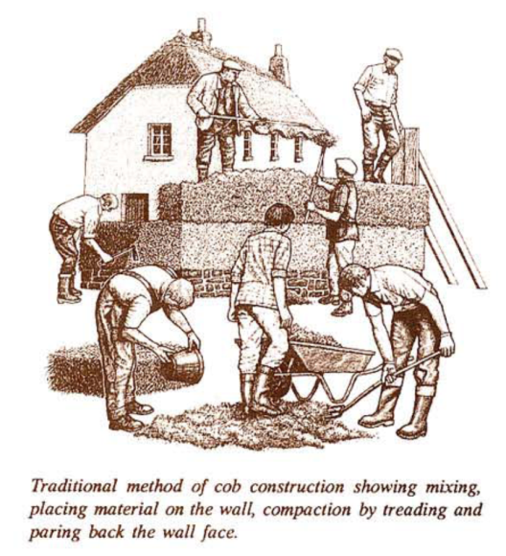
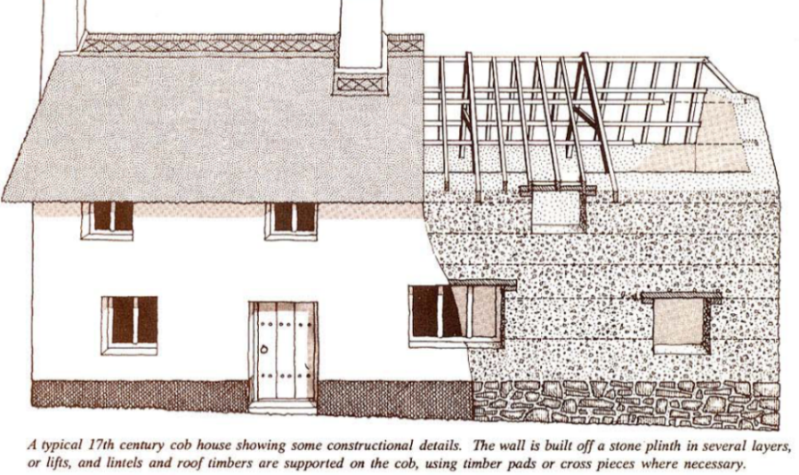
The Material
Cob
Layer of subsoil mixed with straw, laid upon a plinth in layers of approx 700mm high.
Allowed to dry before the next layer is laid and the windows and doors cut out afterwards.
ALWAYS needs ‘gud ‘at and boots’

Slide 7
The Project
The CobBauge project (a merging of the English and French words for the technique) will run until July 2023 and has received funding from the Interreg VA France (Channel) England Programme, co-financed by the European Regional Development Fund (ERDF).
The CobBauge project aims to improve the thermal performance of Cob whilst still maintaining its structural and moisture related properties.

Slide 8
What happened next?
20 mixes of Cob that show ‘promise’
4 mixes, 2 French and 2 UK that are optimal
2 mixes selected for a potential stage 2 project.
This led to a series of design calculations that established the most efficient method of producing a Cob wall to satisfy the thermal regulations. A thermal and a structural mix in one single system.

Slide 9
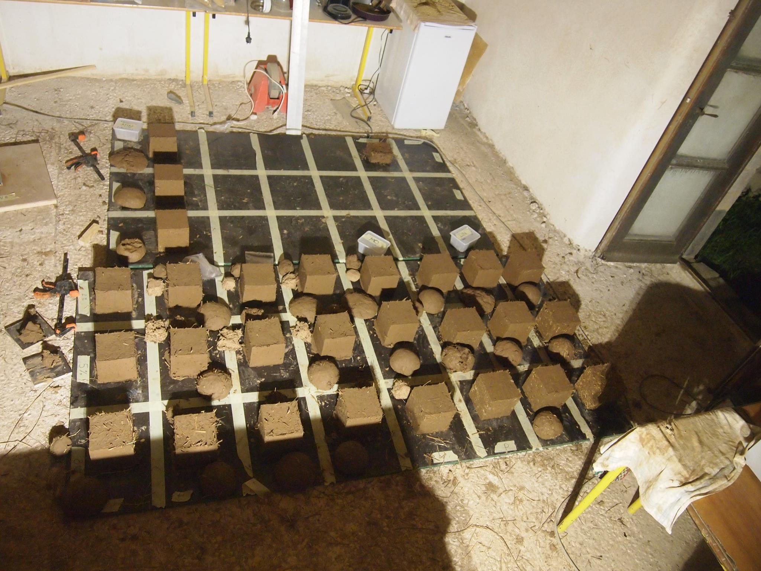
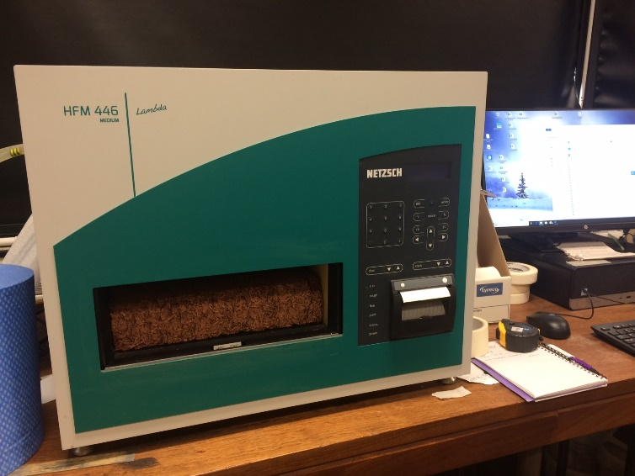
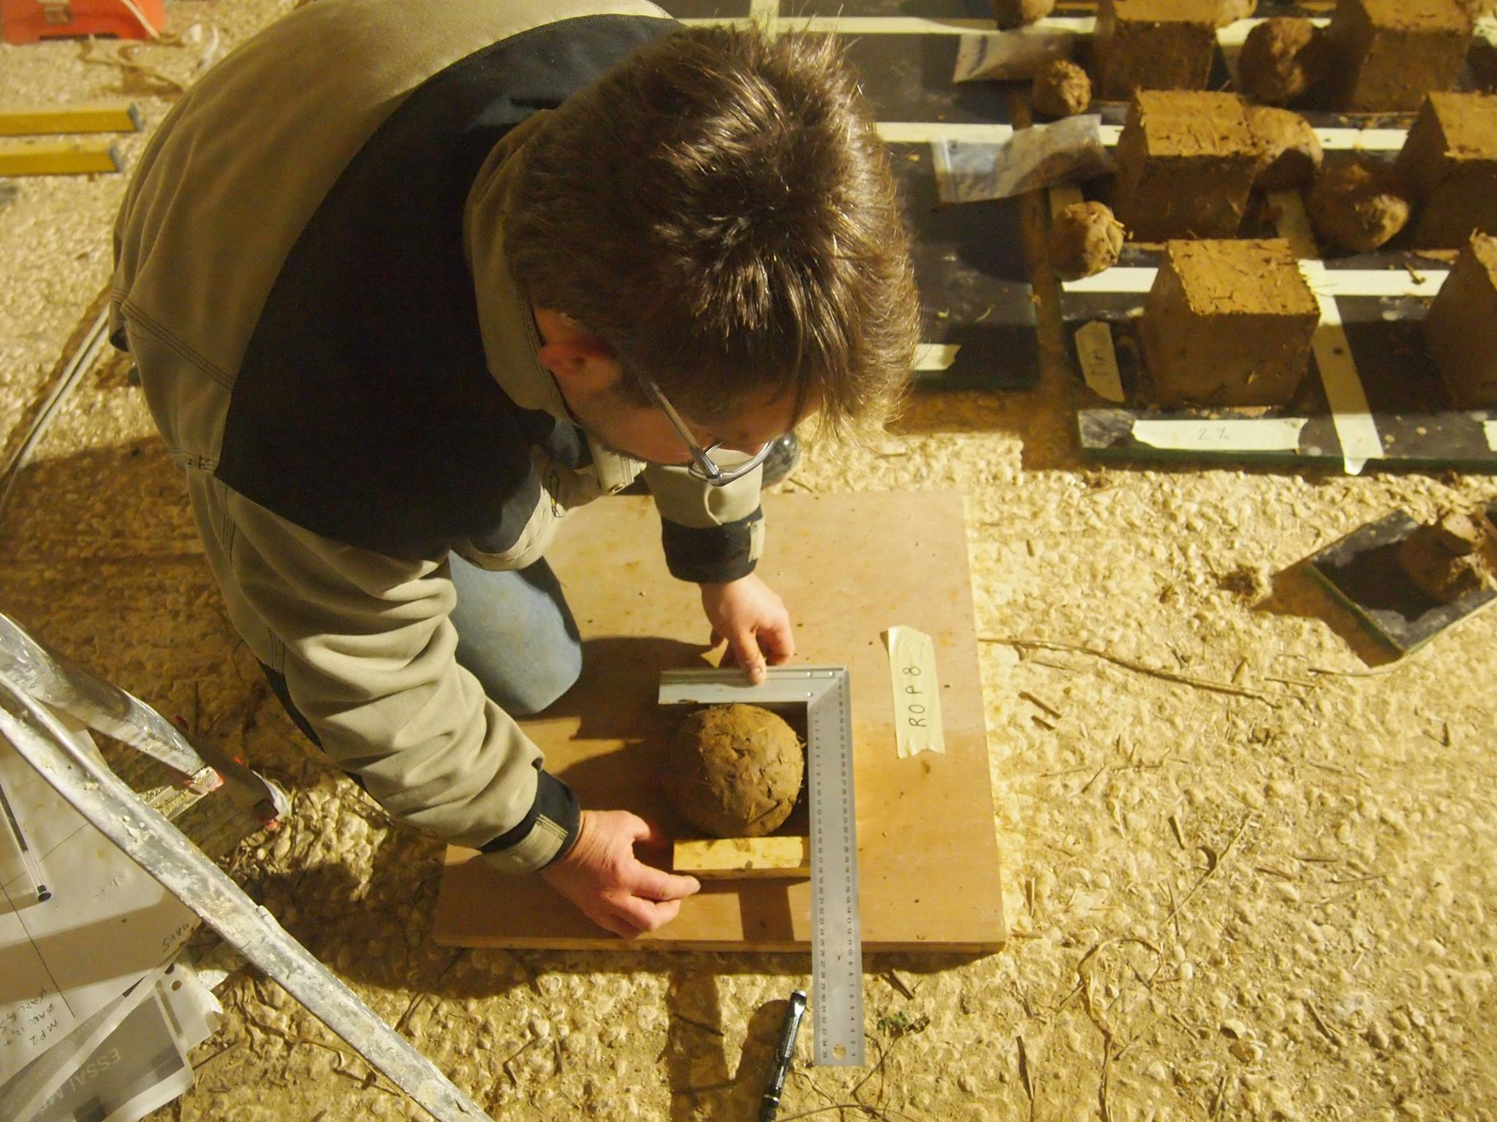

Slide 10
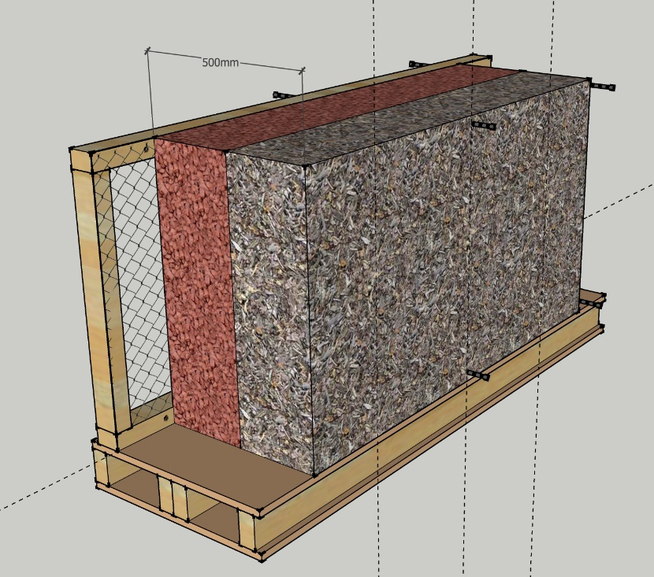
2-layer wall

Slide 11
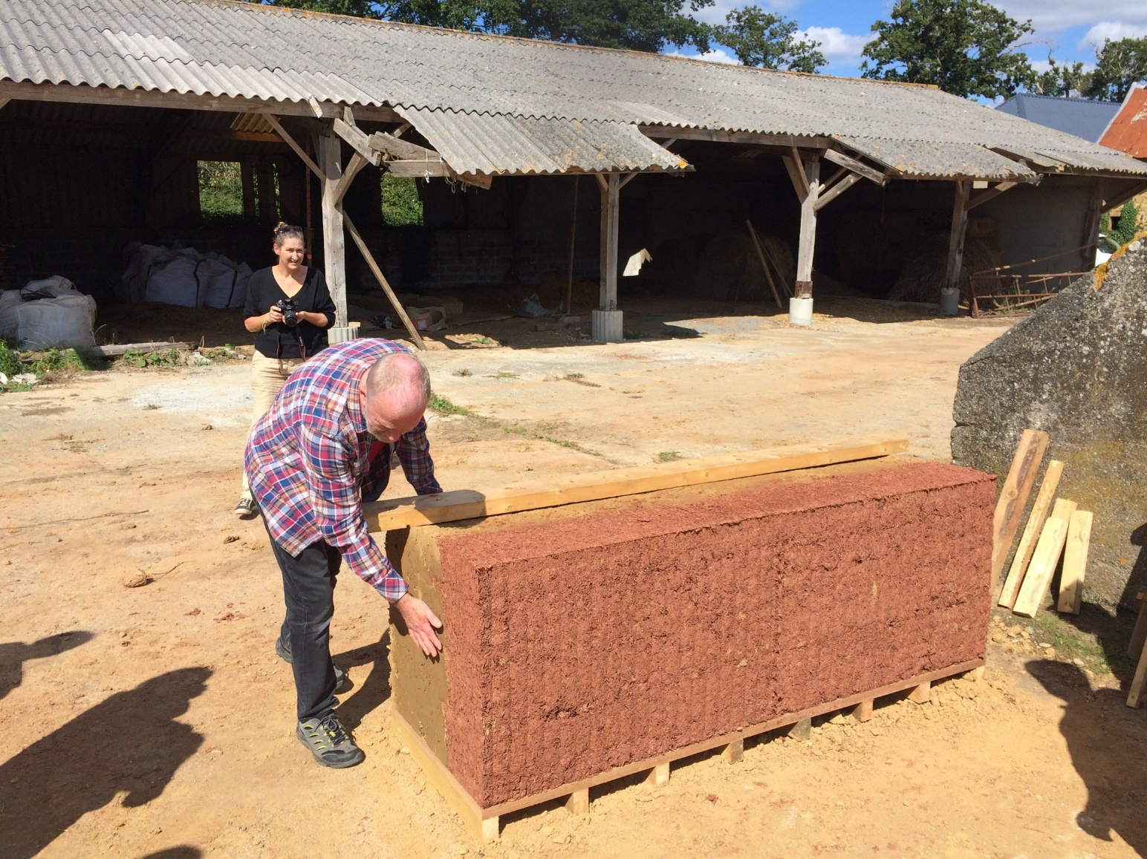
The CobBauge Wall

Slide 12
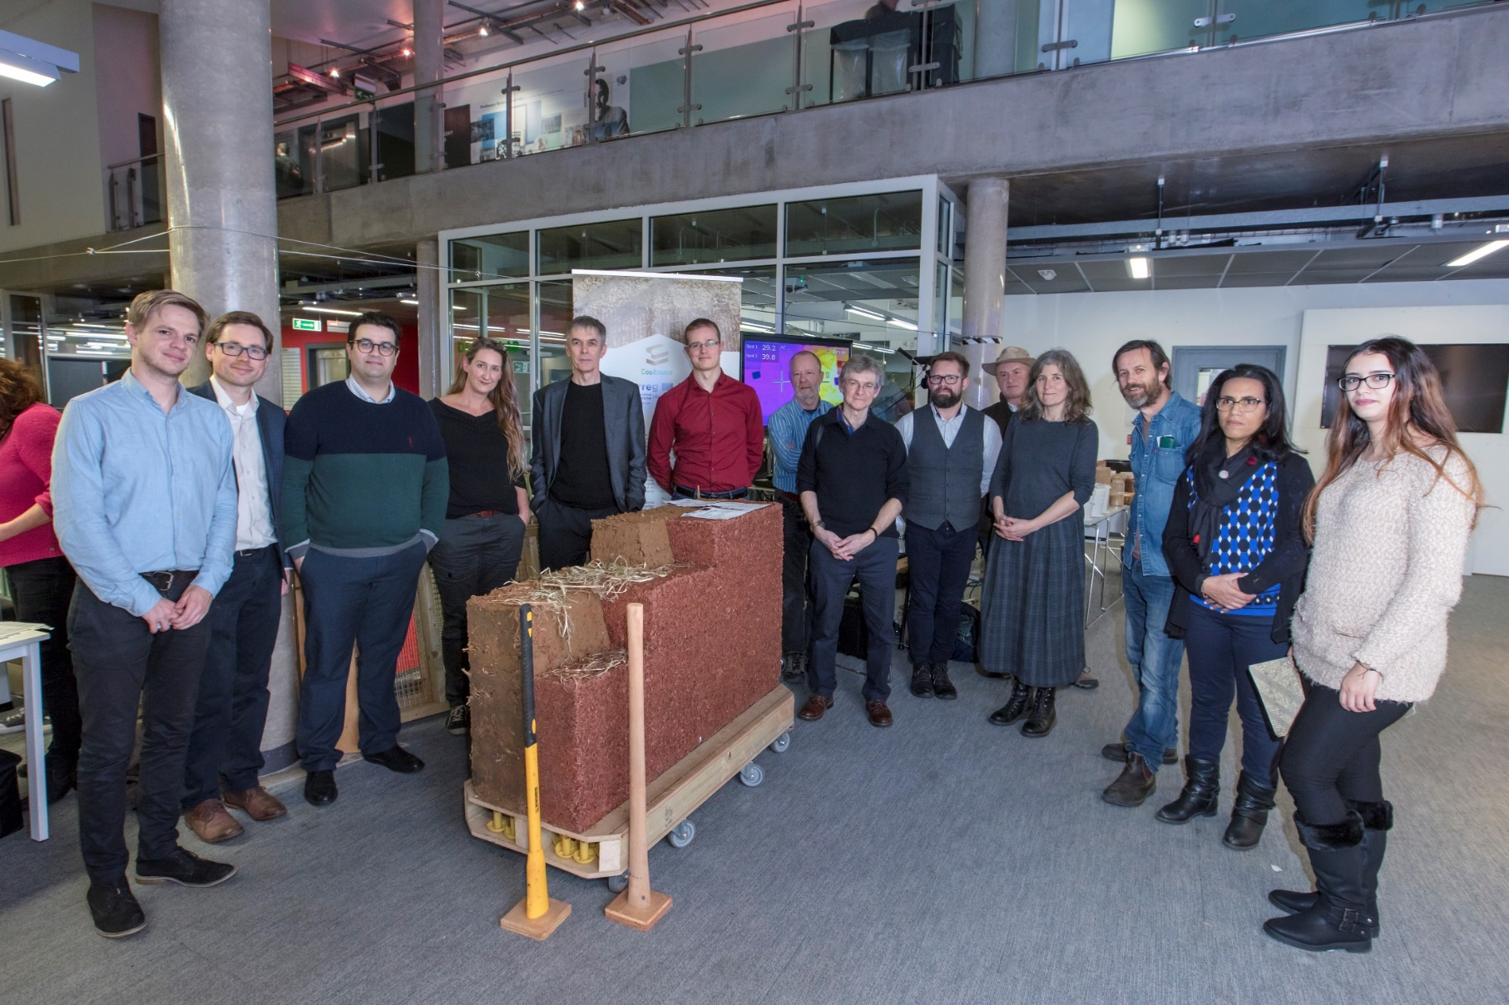
The CobBauge Wall and Partners

Slide 13
CobBauge the 2nd Phase;
Building, monitoring, networks and training

Slide 14
Building
Construction
Why? The need to prove the new CobBauge technology
Two buildings to be constructed, one in France and one in the UK.
Both buildings need to be occupied to give valid comparisons with non-CobBauge buildings

Slide 15
Networks and training
Réseaux et formation
Why networks and training? For any innovation to succeed it needs to be accepted by industry and have people who understand how to use the product.
The initial network will be extended, more professionals and practitioners included including SMEs and local and national authorities.
The two newly completed CobBauge buildings will be the centre point of training activities, both on-site and online materials.

Slide 16
Monitoring of the buildings
Surveillance (des mesures) des bâtiments des mesures
Why monitor/measure? To provide evidence that the buildings perform as expected.
Monitoring/measurements to be undertaken over at least two heating seasons
Measurements taken of Energy, internal air quality and thermal performance.

Slide 17
Thank you …
Now for our 1st main presentation….

